Slide 1
A/B Testing - Upper confidence bond (UCB)

Slide 2

Multi-arm bandit
Inspired in the old slot machines with single lever – also known as one-armed bandits
Strategy to explore multiple one-armed bandits and exploit the one with the best payout
Possible outcomes
Best: knowing the best payout machine and play only on this machine
Second best (ideal): play one time each machine and being able to define the machine with the highest payout and then play only on that machine
Optimized result: results of the slot machine are defined by chance. Goal - optimize the definition of the best machine (exploration) so you can spend more resources playing only in this machine (exploitation)

Slide 3
Approaches to Multi-arm bandit
Random
Exploration
Select the slot machines randomly or equally
Exploitation
Test each slot machine, define the best payout and then play only on this machine
Simple
Epsilon-Greedy
Every play you have an epsilon chance of choosing a random machine slot, and (1 - epsilon) of playing in the highest paying slot machine.
Dynamic
UCB1
It maximizes a function of the current payout of each machine plus a second term that considers how many times you played each machine.
This will give a second chance to machines that had a low payout but were not explored a lot, maybe the bad payout could be just consequence of chance.

Slide 4
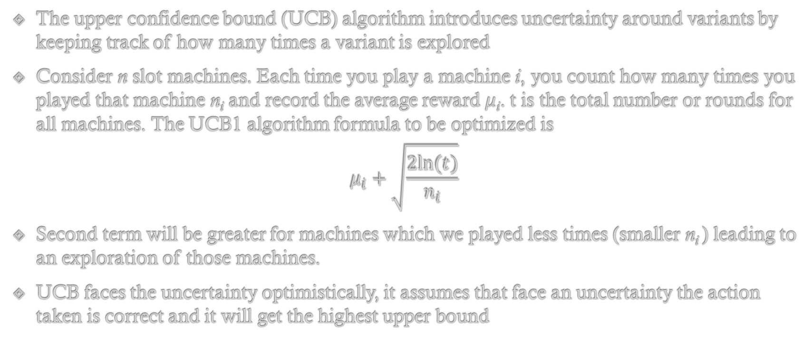
UCB1 method
The upper confidence bound (UCB) algorithm introduces uncertainty around variants by keeping track of how many times a variant is explored
Consider n slot machines. Each time you play a machine i, you count how many times you played that machine n_{i} and record the average reward μ_{i}. t is the total number or rounds for all machines. The UCB1 algorithm formula to be optimized is
$$μ_{i}+\sqrt{\frac{2ln⁡(t)}{n_{i}}}$$
Second term will be greater for machines which we played less times (smaller n_{i} ) leading to an exploration of those machines.
UCB faces the uncertainty optimistically, it assumes that face an uncertainty the action taken is correct and it will get the highest upper bound

Slide 5
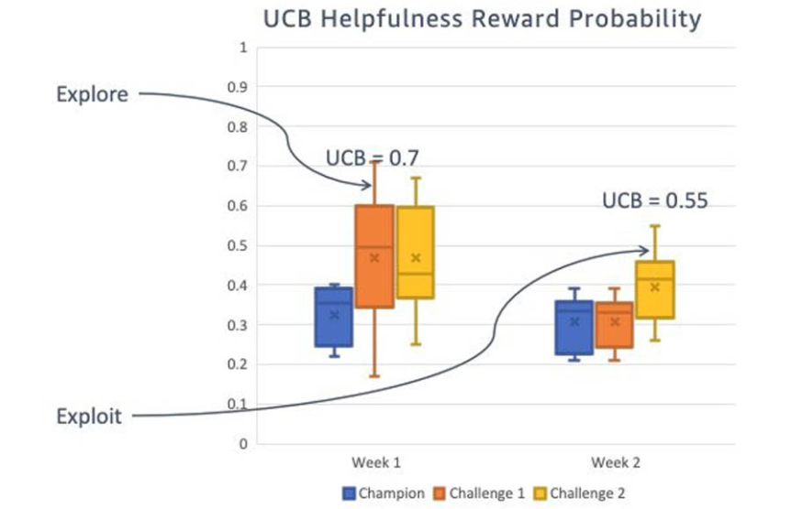
UCB reward probability
In the following example, the Challenger 1 variant is more likely to be selected at the end of week 1 due to a higher upper confidence bound of 0.7.
In week 2 as uncertainty levels drop, we exploit the variants with the highest mean plus uncertainty, which puts the Challenger 2 variant ahead with an upper confidence bound of 0.55
Source: https://aws.amazon.com/blogs/machine-learning/dynamic-a-b-testing-for-machine-learning-models-with-amazon-sagemaker-mlops-projects/

Slide 6
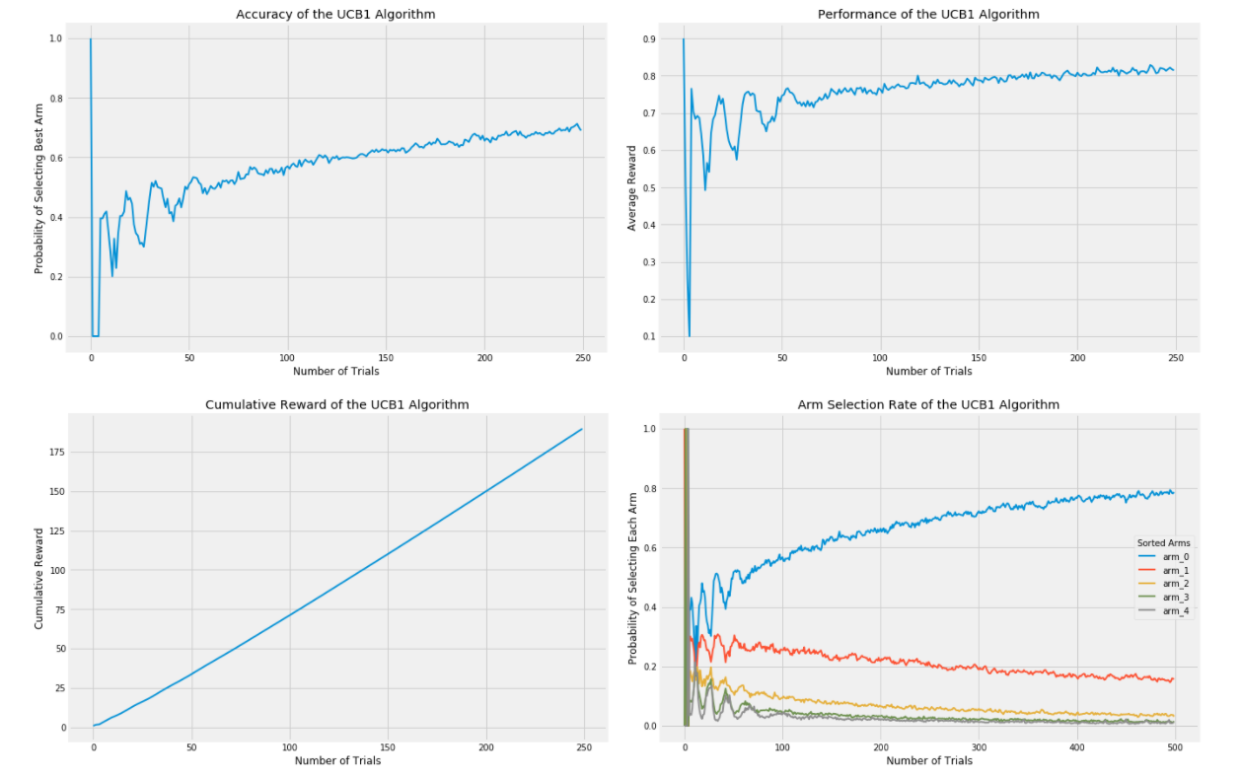
UCB1 performance - example
Source: https://towardsdatascience.com/a-b-testing-is-there-a-better-way-an-exploration-of-multi-armed-bandits-98ca927b357d

Slide 7
UCB2 algorithm
It ensures that your best result is exploit during a certain period
Seasonally it will explore other machines
This behavior is especially important if the outcomes of the machines can change over time and avoid to get stuck with the initial best machine
To achieve this a parameter α is added to tune the length while the winner machine will be exploited
Source: https://towardsdatascience.com/a-b-testing-is-there-a-better-way-an-exploration-of-multi-armed-bandits-98ca927b357d

Slide 8
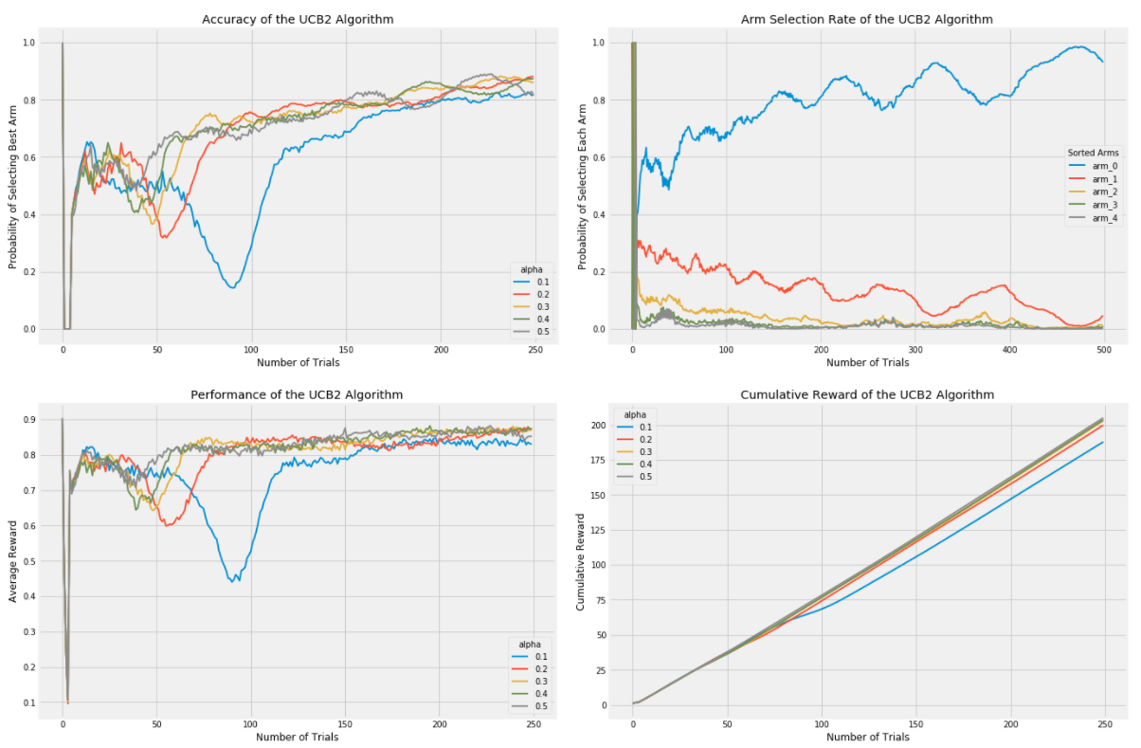
UCB1 performance - example
Source: https://towardsdatascience.com/a-b-testing-is-there-a-better-way-an-exploration-of-multi-armed-bandits-98ca927b357d

